Slide 1
Description
User enters stocks
Tweets gathered using twitter API and stored in database
Use NLTK to analyze the sentiment of the tweets
Use pandas to gather all the price info for the stocks
Use pandas to calculate the stats
Use c3 to create a graph of the price and sentiment for the user to see

Slide 2
Tech Arch
C3- charting stock returns and sentiment
Pandas – gathering stock price information and calculating all that stats we need
Django
Postgres- database
NLTK
Twitter API

Slide 3
UI
Title
Enter your stocks below

Slide 4
UI
Price
-1 to 1 scale
Dates

Slide 5
UI
Description of results with stats

Slide 6
Classes
Twitter Class- gets info from twitter
Twitter Wrapper- adds the info into the database
NLTK Class- sentiment analysis methods
NLTK Wrapper- adds results to database
Stock Data Class- uses pandas to grab historical info
Graph Class- creates a graph of sentiment and returns

Slide 7
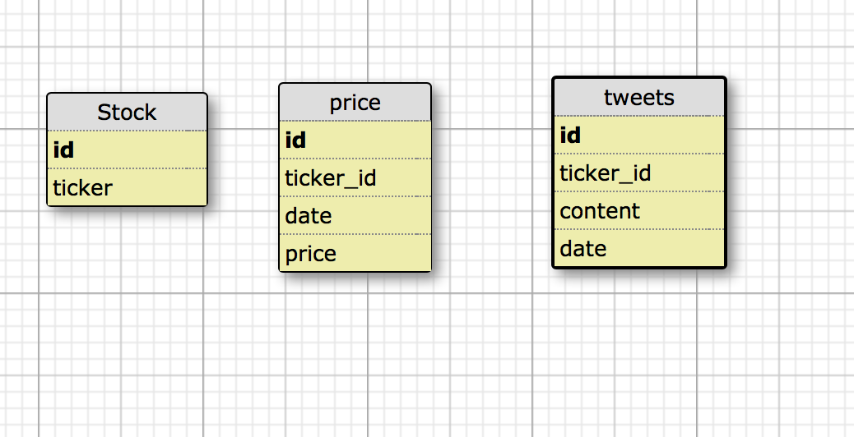
Database

